Slide 1
Employee data analysis using Excel student name: shree harini Register number: 312210364 college: guru shree shanthivijai jain college for women deparment: b.com general

Slide 2
Employee performance analysis using Excel

Slide 3
Agenda
Problem statement Project Overview End Users Our Solution and Proposition Dataset Description Modelling Approach Results and Discussion Conclusion

Slide 4
Problem statement
Using Excel for employee performance analysis can have some challenges, including:
Data organization
Time consuming
Error zone
Lack of real time updates

Slide 5
Project overview
In this project we are going to see how to use Excel in the performance analysis of the employees in a firm

Slide 6
Who are the end users???
The end users of employee performance analysis include: 1. Line managers These managers are usually the ones who conduct performance appraisals because they know the most about the employee’s role and current work. 2. Leadership groups In some cases, a leadership group, team leader, or a more senior leader may lead the review.

Slide 7
3. Human resources Human resources is responsible for developing the overarching system and end-to-end process. 4.Employees Every employee will interact with the performance management system at some stage.

Slide 8
Our solution and it’s valuable proportion
Excel formulas that reference other cells can be put before or after the referenced cells (forward referencing or backward referencing). This is because Excel does not calculate cells in a fixed order, or by row or column. Instead, Excel dynamically determines the calculation sequence based on a list of all the formulas to calculate (the calculation chain) and the dependency information about each formula.
You could use pre recorded excel formats for easy process

Slide 9
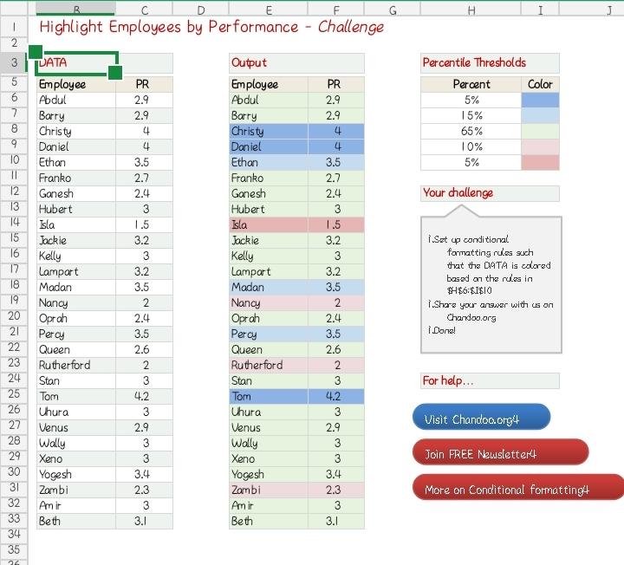
For example this is a pre formatted excel sheet and if you want to record the analysis the same way you could do it with the pre formatted one!

Slide 10
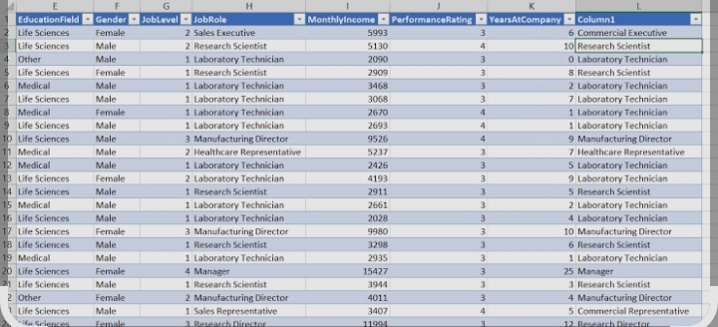
Data set description
In Excel, a data set is a range of cells that contain data to be analyzed. When preparing data for analysis in Excel, it’s important to clearly describe the data with a title

Slide 11
The wow in our solution
Analyze Data in Excel empowers you to understand your data through natural language queries that allow you to ask questions about your data without having to write complicated formulas

Slide 12
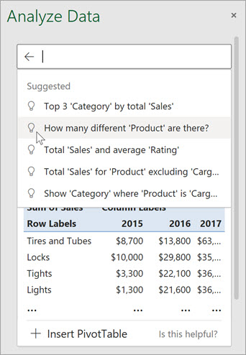
In addition, Analyze Data provides high-level visual summaries, trends, and patterns.
Simply select a cell in a data range > select the Analyze Data button on the Home tab. Analyze Data in Excel will analyze your data, and return interesting visuals about it in a task pane.

Slide 13
Modelling
Here are some ways to use Excel for employee analysis: 1. Pivot tables A powerful tool that allows analysts to focus on data analysis instead of manual programming. To create a PivotTable, select a data cell in an Excel table, then go to Table Design > Summarize with PivotTable. 2. Slicers and filters Slicers are clickable buttons that filter PivotTables. To add a slicer, select a cell in a table, then go to Table Design > Insert Slicer.

Slide 14
3. IF THEN statements Useful for inserting business logic into data. For example, the IF function can test a logical statement and produce a data value based on the result. 4. Data model To add existing data to a model, select a cell in the data, then click Power Pivot > Add to Data Model. 5. Analyze Data button Select a cell in a data range, then select the Analyze Data button on the Home tab. This will analyze the data and return visuals in a task pane.
6. Analysis ToolPak This tool can save time by using statistical or engineering macro functions to calculate and display results in an output table

Slide 15
Results
Here are some things you can do with Excel to analyze employee data: 1. Calculate metrics:
Use Excel formulas to calculate metrics like termination rate, age category, hire year, and employee tenure. 2. Create PivotTables:
Use PivotTables to quickly calculate group-level summary statistics, like the average, minimum, or maximum value per group. For example, you can compare monthly salaries between departments.

Slide 16
3. Analyze data with Analyze Data:
This feature in Microsoft 365 analyzes data and returns visuals in a task pane. You can enter questions in the query box to get answers, or select suggested questions. 4. Visualize survey results:
Use charts to visualize survey results, especially those that use a like-hurt format. For example, you can use a stacked bar chart to visualize survey responses that range from strongly disagree to strongly agree. 5. Import and analyze data:
Use the Get & Transform function to import data from multiple HR systems. 6. Present insights:
Use Power BI to present your insights in an interactive dashboard.

Slide 17
Conclusion
Here are some conclusions about using Excel for employee analysis: 1. Analyze Data This feature in Excel can analyze data and provide visuals such as charts, tables, or PivotTables. It can also suggest questions based on the data. 2. Key metrics calculation Excel formulas can be used to calculate key metrics like termination rate, age category, hire year, and employee tenure.

Slide 18
3. HR Analytics dashboard This dashboard can provide insights into HR metrics and trends, such as job satisfaction, attrition rate, and employee demographics. It uses data cleaning, summarization, and visualization techniques. 4. Data analysis features Excel has many features that can be used for data analysis, such as applying formulas, sorting information, and performing complex calculations. 5. Real-time collaboration With Office 365, multiple users can edit the same spreadsheet simultaneously. This feature can improve collaboration and ensure that everyone has access to the most recent data.

Slide 19
Thank you !

